Slide 1
Introduction to Robotics
CSE 461
Lecture 8: Robot Navigation
Niloy Irtisam
Lecturer, Dept. of Computer Science and Engineering
Brac University

Slide 4
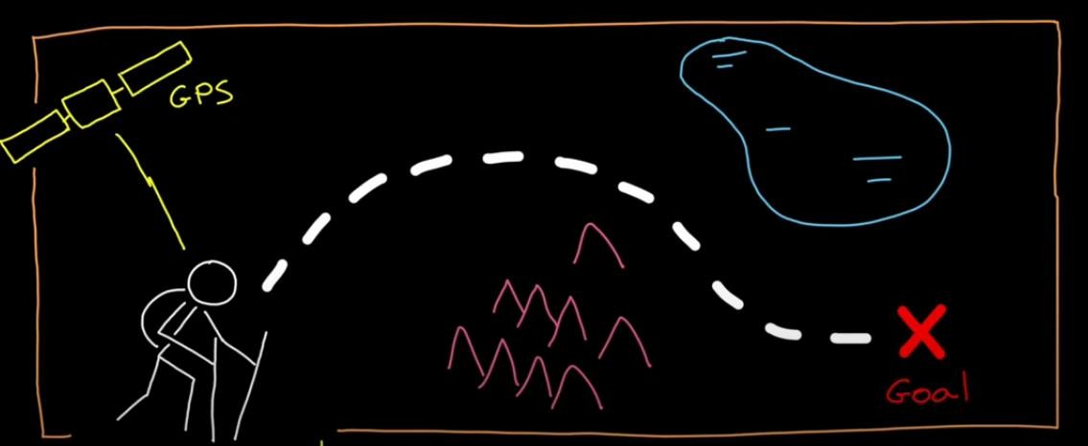
Navigation
The act, activity, or process of finding the way to get to a place
Navigation is the ability to determine your location and plan a path to some goal

Slide 5
Robot Navigation
For autonomous behavior, robots need the ability to navigate:
Learn the environment->“Model”
Estimate where it is in the environment->“Localize”
Move to desired locations in the environment

Slide 6
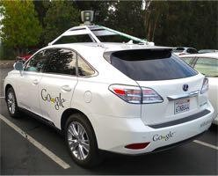
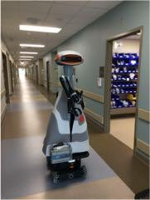
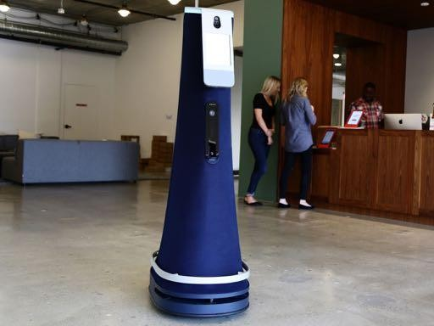
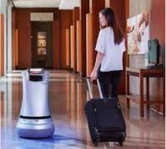
Navigation Example
GOOGLE CAR
DILIGENT
Scenarios
•Hospital Helper
(e.g. Diligent, Tugs)
•Office security or mail-
delivery
(e.g.Cobal, Savioke)
•Tour Guide robot in a
museum (Minerva)
•Autonomous Car with GPS
and Nav system Biological analogies: Humans, bees and ants, migrating birds, herds
COBALT(office)
SAVIOKE
(hotels)

Slide 7
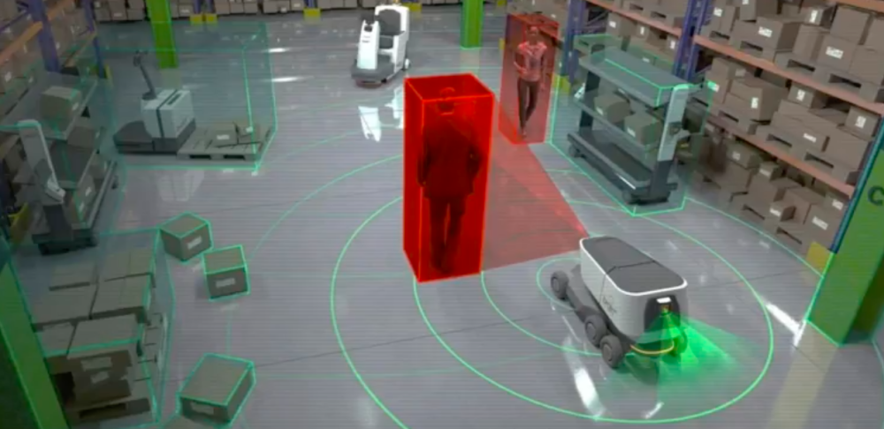
Environment

Slide 8
Navigation Problem
Problem Characteristics
Environments are Known versus Unknown
Environments are Static versus Dynamic
Environments are Structured versus Unstructured (Indoors versus Outdoors?)

Slide 9
We have to design the navigation system

Slide 10
Robots Navigating
Path Planning: How I get to my Goal?
Localization: Where am I?
Mapping: Where have I been?
Exploration: Where haven’t I been?

Slide 11
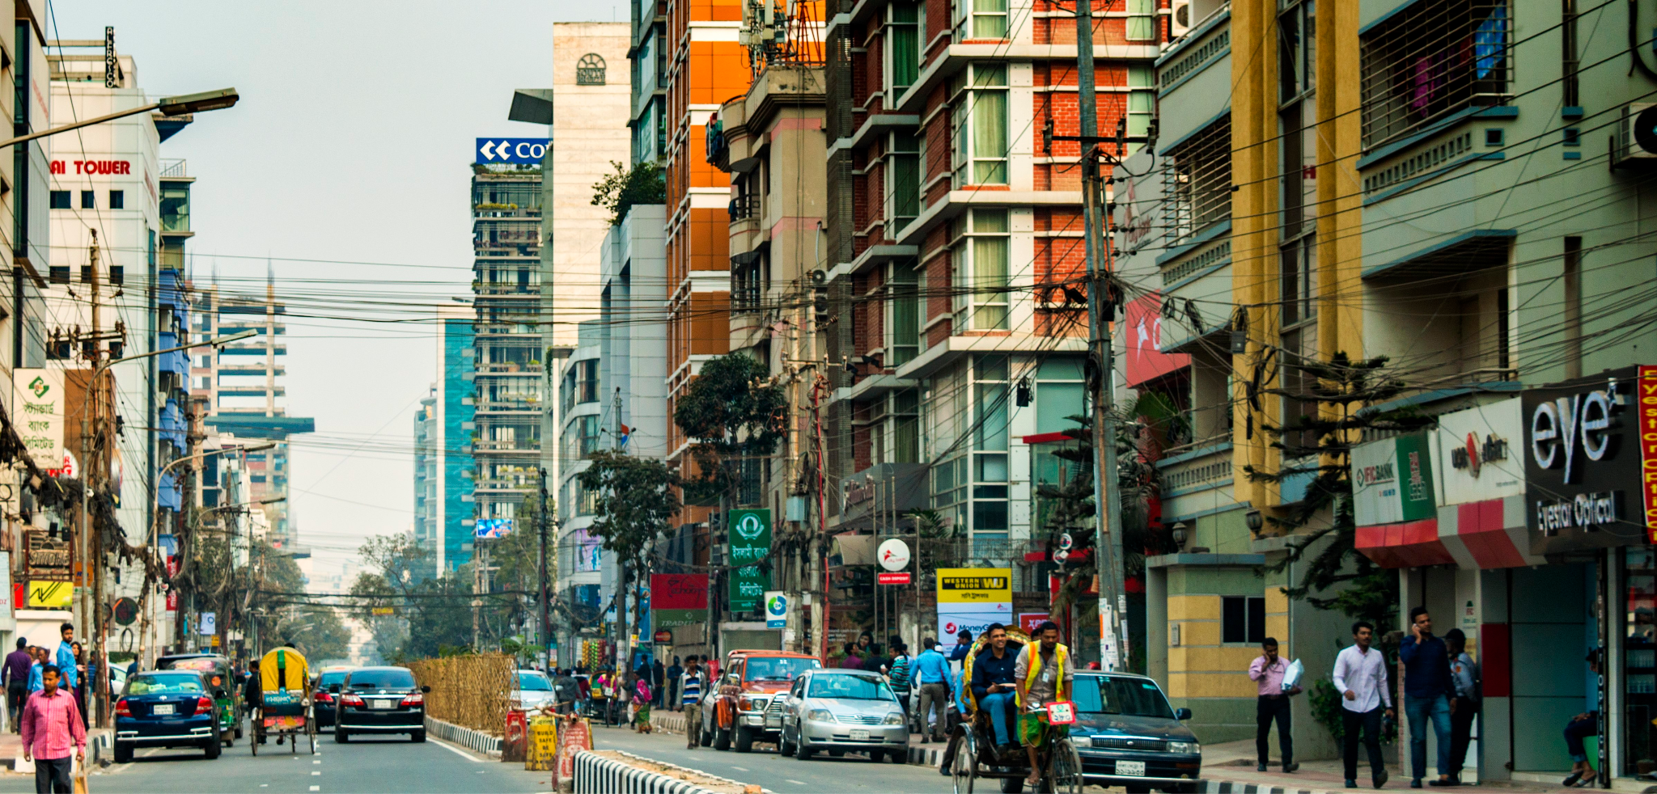
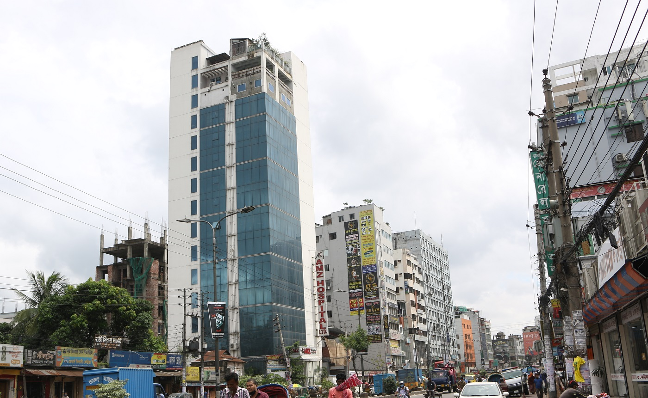
What is Path Planning?
Faster
Easier
Banani
Energy Efficient
Badda

Slide 12
What is Path Planning?
Simple Question: How do I get to my Goal?
Not a simple answer!
Can you see your goal?
Do you have a map?
Are obstacles unknown or dynamic?
Does it matter how fast you get there?
Does it matter how smooth the path is ?
How much compute power do you have?
How precise is your motion control?
Path Planning is best thought of as a Collection of Algorithms
3 Things need to consider: Environment, Success metrics, Robot capability.

Slide 13
We know our criteria now what?

Slide 14
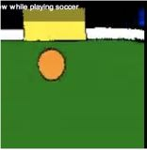
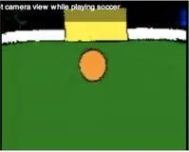
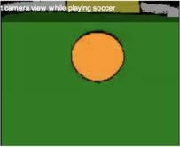
Basics: Visual Homing
Purely Reactive Navigation
Measure Visual (x,y) Position of Goal
Move to bring goal to Visual Center
Proportional Control (if you see the goal), Random walk (if you don’t)

Slide 15
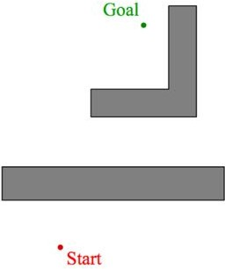
Bug-based Path Planning
What if the Robot has obstacles in the way?
Always have Goal direction and/or distance (Global)
But No Map: Only local knowledge of environment (Local)
Very intuitive class of algorithms – but surprisingly powerful

Slide 16
What if the map is given ?

Slide 17

Map Representation: Feature based

Slide 18
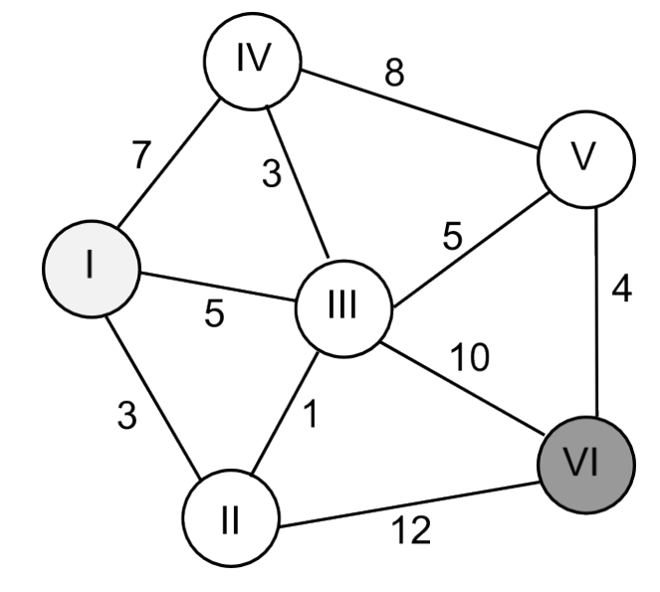
Path Finding Algorithms
All Map Representations are a weighted “graph”
Nice part is that you only need to do this once
Algorithm: Compute shortest paths in the graph
Path is represented by a series of waypoints

Slide 19
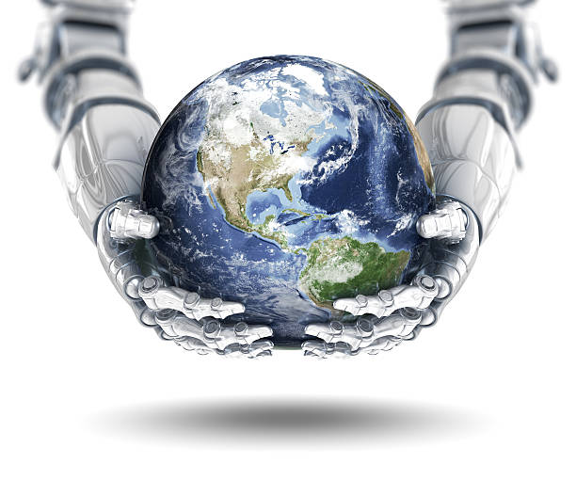
Metric/Global Path Planning
What if the Robot has Full Knowledge
A map of the environment and robot + goal’s locations
Goal: Find a “optimal” path (typically distance)
Two Components
Map Representation (“graph”)
Path Finding Algorithms:
Shortest-Path Graph Algorithms (Breadth-First-Search, A* Algorithm)

Slide 20
Types of Path Planning Approaches
Basics
Visual homing (Purely local sensing and feedback control)
Bug-based Path Planning (mostly-local without a map)
Metric (A*) Path Planning (global with a map)

Slide 21
Robots Navigating
Path Planning: How do I get to my Goal?
Localization: Where am I?
Mapping: Where have I been?
Exploration: Where haven’t I been?

Slide 22
Localization
Simple Question: Where am I?
Not a simple answer:
Do you have a map?
Yes => a global position in the world
No => position in reference to other objects? Or your own past?
What can you sense?
Can you sense and record your own self-movement? Can you sense external things like landmarks?
How certain are you about what you sense?
Localization is a “collection of algorithms”

Slide 23
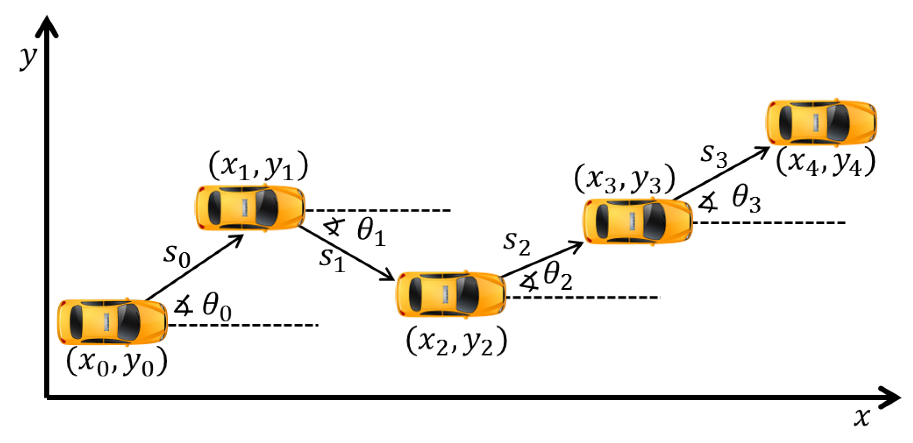
Dead-Reckoning(Motion)
Keep track of initial position and the series of movements/actions that you made.
Method: Take a “step”, compute new position.
Also called odometry or path integration Example: Inertial navigation systems (INS)

Slide 24
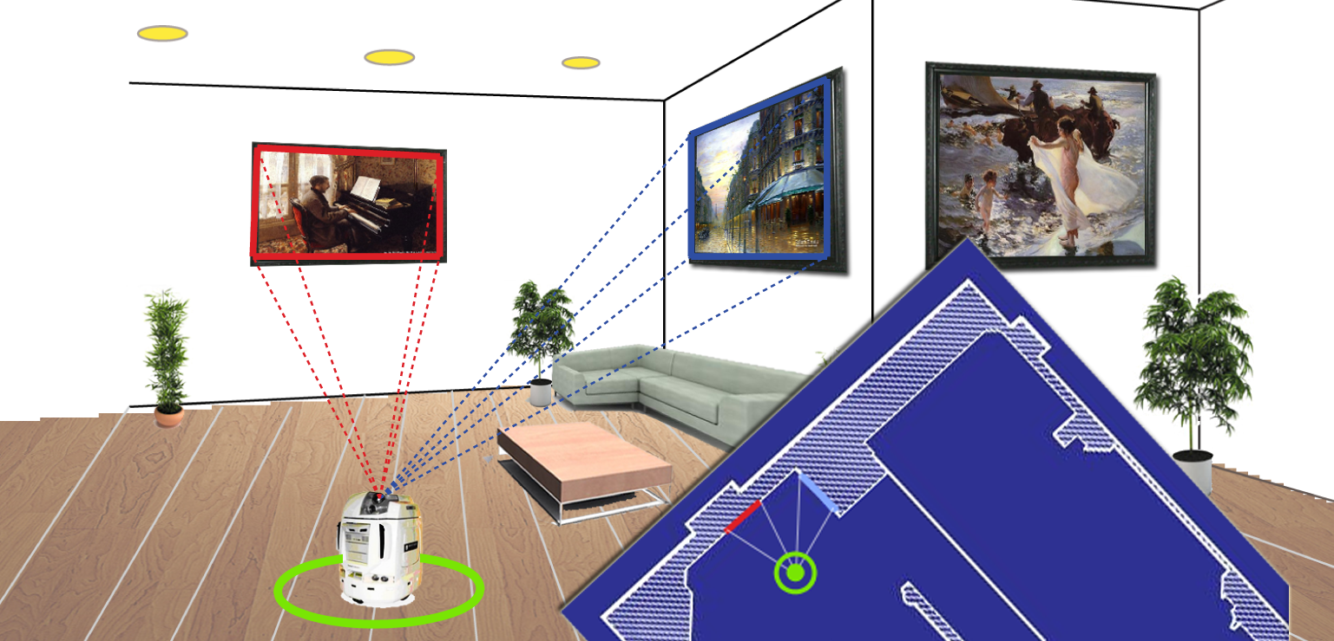
LandMark(Sensing) Based
How it works
🡽 Opposite of dead-reckoning!
🡽 Use measurements to external landmarks of known position
🡽 Examples: visual landmarks, radio towers, GPS!

Slide 25
State Estimation (uncertainty in motion & sensing)
Key Idea: Combine Motion and Sensing
(Dead-reckoning + uncertainty) + (Landmarks + uncertainty)
Each has error, but the error can be complementary
Kalman Filters
Particle Filters (Monte Carlo Localization)
Sensing Model
Motion Model
Actual System

Slide 26
Localization Techniques
Dead-reckoning (motion)
Keep track of where you are without a map, by recording the series of actions that you made,
using internal sensors. (also called Odometry, Path Integration)
Landmarks (sensing)
Triangulate your position geometrically, by measuring distance to one or more known
landmarks
E.g. Visual beacons or features, Radio/Cell towers and signal strength, GPS!
State Estimation (uncertainty in motion & sensing)
Probabilistic Reasoning
Kalman Filters (combine both motion and sensing)
Particle Filters (also known as Monte Carlo Localization)

Slide 27
Next Class

Slide 28
Robots Navigating
Path Planning: How to I get to my Goal?
Localization: Where am I?
Mapping: Where have I been?
Exploration: Where haven’t I been?

Slide 29
Thank You

